Slide 1
Improving Retention and Graduation Rates through Student GPS, Performance Dialogs and Putting Students First
Eastern Maine Community College

Slide 2
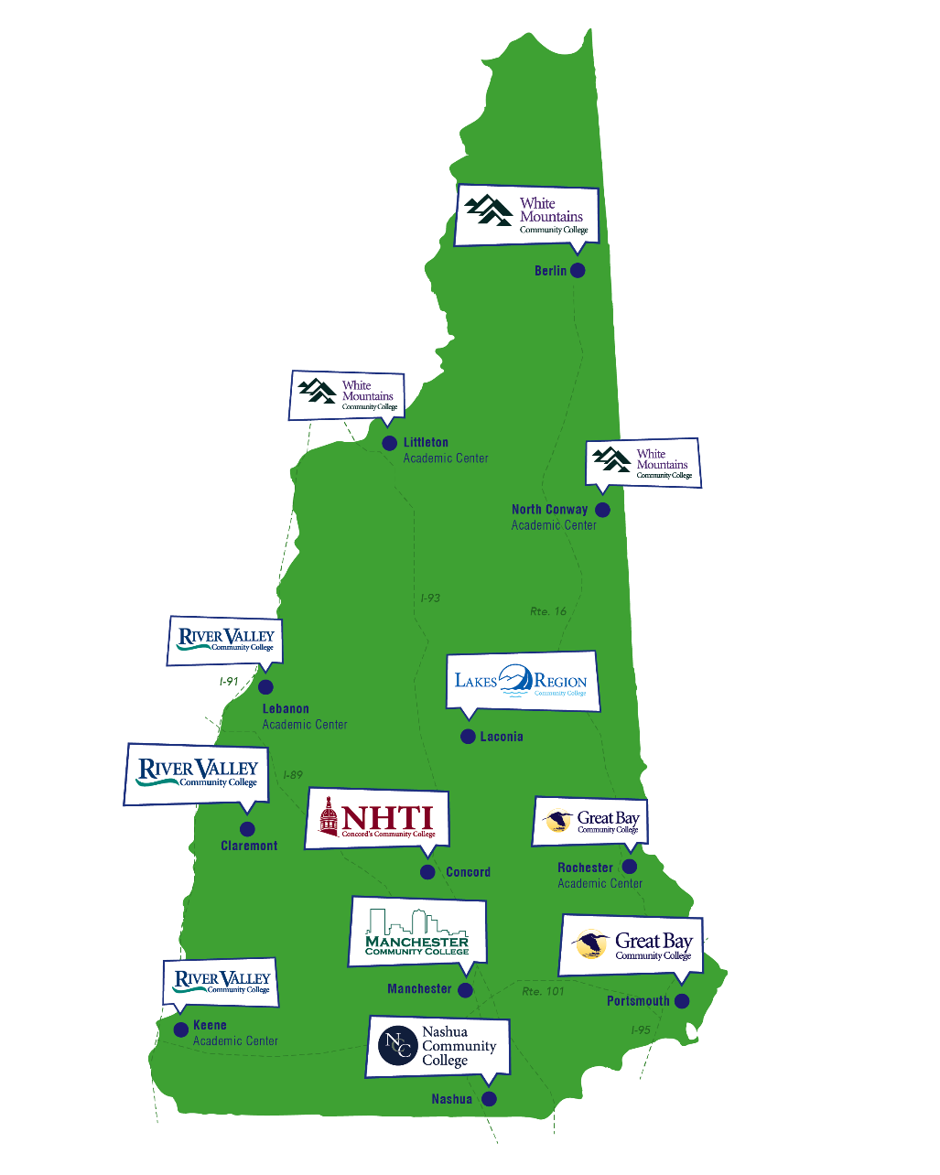
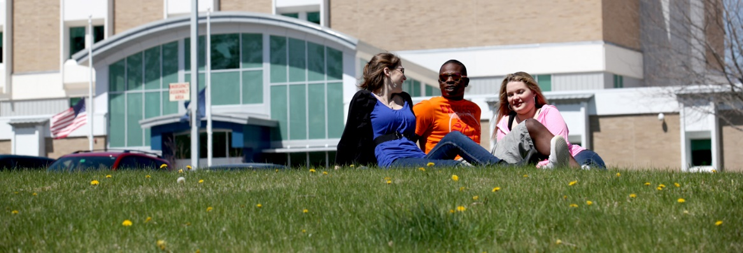
CCSNH’s mission centers on student success and access, aligning with workforce and educational attainment needs
CCSNH serves 26,00 students annually, which translates to roughly two percent of the adult population of New Hampshire any given year is a CCSNH student, once you exclude dual-credit programming
For Spring 2018
48% are 20 years old or under, 24% ages 21-25, and 28% ages 26+
66% of our students are part-time

Slide 3
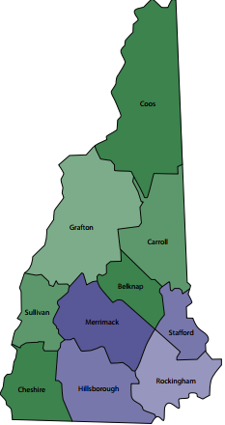
The rural and mountainous north and west differ significantly from the more urban and populous counties in southeastern NH
Following the highways from Boston, the NH metro counties include the Route 3 and I-93 cities and suburbs of Nashua, Manchester and Concord and the I-95 Seacoast cities of Portsmouth, Exeter, Dover and Rochester and their surrounding towns. These counties comprise 74 percent of NH population
 | Total NH | Rural NH | Metro NH | Top State* | Bottom State*
Associates + | 46% | 38% | 47% | 51% | 28%
Rank | 7 | 28 | 3 | 1 | 50
Bachelors+ | 33% | 30% | 35% | 39% | 18%
Rank | 9 | 19 | 6 | 1 | 50
Source: http://www.ccsnh.edu/sites/default/files/white-paper-series-the-two-new-hampshires.pdf

Slide 4
Job Postings and Job Seekers Gap
CCSNH degree and certificate programs in “sweet spot” of high employability for individuals and labor market alignment for NH economy
 | Workforce Size | Unemployment | Job seekers | Job openings
Graduate or professional degree | 94,080 | 1.9% | 5,531 | 9,522
Bachelor's degree | 154,560 | 1.9%
Associate degree | 67,200 | 1.2%
Some college, no degree | 127,680 | 2.9% | 13,380 | 6,132
High school graduate or equivalent | 181,440 | 3.7%
Less than 12th grade or less | 47,040 | 6.3%

Slide 5
65 X 25 goals fall within our mission and influence our work
The Community College System of NH has introduced 65 by 25, a goal to help ensure that 65 percent of adults 25 and older in New Hampshire will have some form of post-secondary education, from certificates to advanced degrees, by 2025. Achieving this goal moves New Hampshire much closer to targets cited in national research and positions New Hampshire to support a strong future economy.
Failure to reach that goal will harm the state’s ability to retain, attract and grow business, and will have long-term effects on the state’s economy and quality of life.

Slide 6
Demographic context
At the two-year colleges we anticipate more or less flat enrollments until the middle of the 2020s. After that, things get pretty grim….If your institution is an outlier on the positive side, that just means that the negative reckoning that your peers are facing is even worse than the projection. It’s got to average out.
For most institutions, you’re not going to recruit your way out of this demographic change. That means your retention policies become so much more important. If you are losing 20 or 30 or 40 percent of your students, your best strategy might easily be to apply what we increasingly know from the literature are best practices to improve retention.

Slide 7
These challenges impact educational leaders in the region, not just CCSNH
Maine
Lost 0.07 percent between 2014 and 2015, compared to a gain of 0.79 percent in the United States as a whole.
Had a 2014 - 2015 rate of population change that ranked 46th - from highest to lowest - in the United States.
New Hampshire...
Grew by 0.20 percent between 2014 and 2015.
Had a 2014 - 2015 rate of population change that ranked 38th - from highest to lowest - in the United States.
Vermont
Lost 0.12 percent between 2014 and 2015, compared to a gain of 0.79 percent in the United States as a whole.
Had a 2014 - 2015 rate of population change that ranked 48th - from highest to lowest - in the United States
Source: Demography. UNH Carsey School of Public Policy. https://carsey.unh.edu/policy/demography

Slide 8
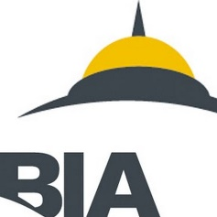
Over the next several years, CCSNH continues work to make sure enough students graduate with a valuable credential to meet 65 by 25 imperative
All programs must have economic and transfer value
This translates, in the classroom, to vibrancy in teaching and learning, on top of curriculum informed by 4-years and employers
Student GPS means helping students succeed by making plans that are
2
3
Relevant | Intentional and Structured | Pace to Completion
Purposeful choice Appropriate Math Faculty-authored pathways Understanding of what it takes to be successful in College | Meta-major-based academic pathway choice Prescribed semester-by-semester coursework Block scheduling Registrations on plan | Firm understanding of what “two-year” college actually means Acceleration for developmental education
1

Slide 9
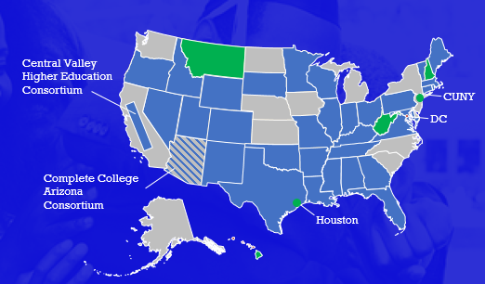
NH is one of four states to be called out nationally for its momentum in GPS work, including for success in grad rates, academic readiness, credits accumulation and other measures

Slide 10
GPS strategies represent levers from which we forward our success agenda
Pathway Relevance
Purpose First Math Pathways Guided Pathways | All students access Career Coach technology in advising process for purpose-driven decision-making Math pathways in place at most Colleges, with co-requisites designed from them All programs of study mapped, semester-by-semester Transferable first-semester success courses for all
Pathway Intentionality
Structured Schedules | Seven common focus areas, including with K-12 Introducing technology to all Colleges to ensure all students register onto semester-by-semester plans Enabling predictive and block scheduling Enabling measures around plan quality
Pathway Pace
Co-requisites | Co-requisites impact majority of students by Fall 2018 15/30 credits the new normal for full-time

Slide 11
For NH, Purpose First begins in K-12
Recruitment Activities
CCSNH is sharing its recently launched Career Coach platform with high school counselors so students will be well-informed on higher education options and offerings before registration take junior- and senior-level courses strictly in alignment with prospective academic pathways.
Using focus areas to work with K-12 system
K-12 has adopted CCSNH’s seven focus areas (meta-majors) Targeting end of November full mapping of junior- and senior-level courses for each focus area, to tighten dual-credit and dual-enrollment programs to education options in New Hampshire. Using CollegeBoard information collected during SAT – mandatory in 11th grade – for info on interests to target advising
Partnership with Employers
New Hampshire has one of the lowest unemployment rates in the country
Employers do not have enough talent to fill needed positions
Outreach from employers to higher education for dynamic curriculum work is always a challenge
CCSNH will shortly go live with an employer-centric Web portal for navigating programs and contact information depending on skills required – a corollary to the Career Coach on the student-side to help academic supply meet business demand.

Slide 12
EMSI and EAB help solve planning and persistence
 | Guided onboarding with custom enrollment steps individualized to each incoming students’ needs; providing personalized support at entry for all students to clarify paths to end goals Smart academic planning to match students to best-fit carriers and relevant courses; balancing structure with flexibility for part-timers to help students choose and enter a pathway 360 advisor dashboard empowers frontline staff to meaningfully reach cohort to empower advisors as completion coaches to help students on path. Actionable administrator view gives leaders relevant data to serve students and report on outcomes; highlighting the most relevant data for leaders to ensure all students are learning.
 | Research career interests and conduct career assessment, learning about each career’s typical tasks and requirements to gauge fitness Evaluate careers based on how much they pay and whether that industry is expected to grow See which companies do the most hiring and explore live job postings to learn what they want from employees Map career information to pathways

Slide 13
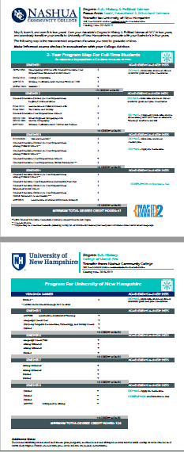
Pathways and articulation: Create clear, 8-semester, 2+2 maps at each of USNH’s institutions.
Creating 2+2 maps make it very clear what a student needs to take upon starting his/her associate’s – showing exactly which courses transfer, together, to achieve junior standing at baccalaureate institutions
They also represent vehicles for depicting present curriculum, including any gaps towards full program-level articulation
Emphasizing creating single 2+2’s with one or more CCSNH institution to one or more USNH institution is the critical starting point towards universal program articulation
Leveraging work already underway, this Fall we will
Depict initial pathway to understand what courses to target
Push for course equivalences across all CCSNH institutions to targeted USNH for particular 2+2’s
Seal program articulation
Map to other USNH institutions
CCSNH and USNH create required program codes to track enrollment, and start building transfer activities that can use the new pathway as an anchor.

Slide 14
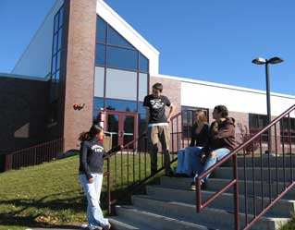
Which type of organization is more likely to be using data to transform its industry and realize its mission statement?
Future of workforce, baccalaureate, and civic engagement
Future of spice and texture in dehydrated foods

Slide 15
Principles and process of performance dialogs
Metrics
Dialogs
Description
Description
Long-term outcomes
Overview of outcomes / KPIs with less frequency
E.g., 65 by 25 metrics
Dialogs
Frequency depends on organizational level
E.g., Monthly CFO meeting. Board?
Leading indicators
Overview of effectiveness and efficiency factors that influence outcomes
Operations
Identify actions to improve outcomes
E.g., Action Items

Slide 16
Guiding Principles for Performance Dialogs
Description
System-wide ownership for our goals
The purpose of Performance Dialogs is to provide a process to continually review and refine organizational practices using a data-driven, evidence-based lens
Every individual in the organization has ownership and responsibility in realizing goals
Leadership and management capacity
Our system must have leaders at all levels model change management mindsets and behaviors
Train, develop, and coach individuals to identify problems through data and work with their teams to address the problems proactively and effectively
Culture of data inquiry
Train and develop individuals to quickly analyze data to solve organizational problems
Encourage individuals to creatively and persistently inquire using data to understand complex problems
Culture of action and accountability
Develop agility to address problems and follow-through
Accountability system needs to be simple, transparent

Slide 17
Discussion Questions – Answer them with Action Items
Performance Dialogs
What are your student success goals and how do you measure them?
This seems like a basic question but do you know what these are, off the top of your head, and who talks about them and when? These anchor the strategic GPS work, among other initiatives.
What performance dialogs do you have in your institution, and at what levels?
Student GPS
Which 2-3 key GPS-related initiatives are already planned or make sense for your College(s) to pursue in advance of going live in Fall 2020?
By what metrics will you know they are successful?
Who will talk about them, and with what regularity?
What does equity mean for your state? For NH, it’s bridging rural and metro divides, among others.
Are you offering adult learners on-ramps by recognizing prior learning and innovative schedules?
Do you offer dual-credit students courses, or pathways?
Technology
Do your systems entrench key GPS precepts around credit load, default maps, structured schedules, etc?
What do you provide to democratize data access at your college?

