Slide 1
Using Labor Market Information to Support Decision-Making: The Why and How
John Dorrer, Labor Economist
Diane Vickrey, MCCS Director of Institutional Research

Slide 2
Today’s presentation
What is Labor Market Information (LMI)?
How do I use LMI for planning?
Reports and examples
Why use LMI?

Slide 3
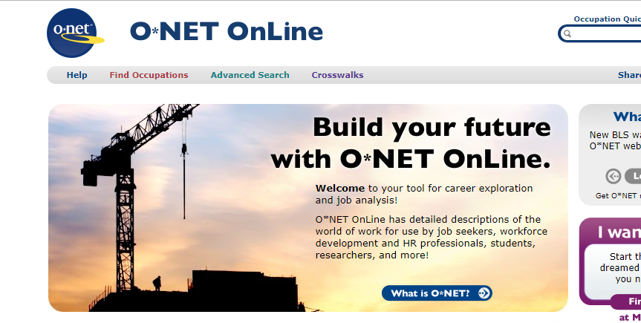
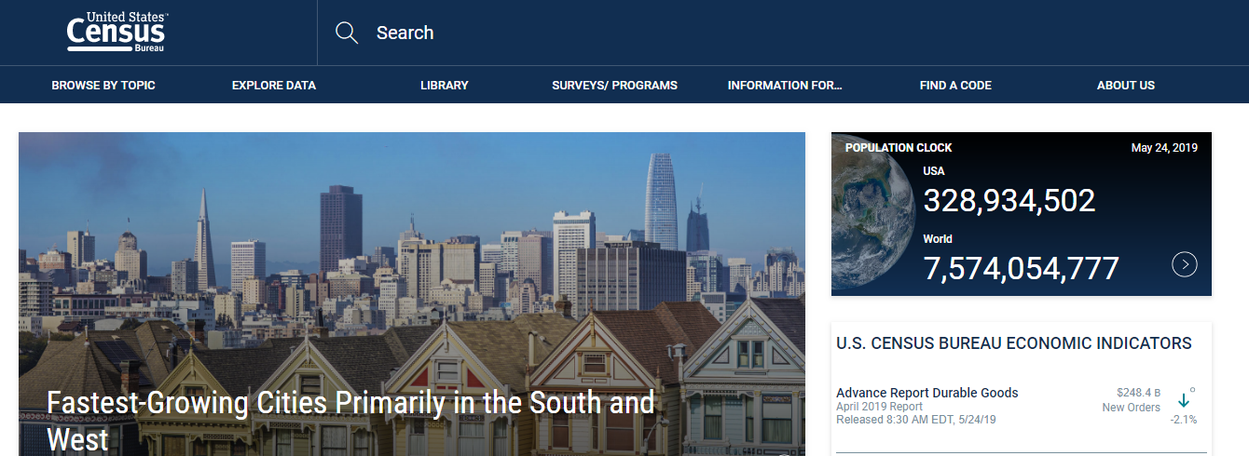
What is Labor Market Information (LMI)?
Occupational growth
Wage projections
Regional job statistics
Skills and credentials in demand
Other work-related information
Notes:
Labor market information includes all quantitative or qualitative data and analysis related to employment and the workforce.

Slide 4
CIP, SOC, NAICS, O*NET – Oh, my!
CIP (Classification of Instructional Programs) = PROGRAM
SOC and O*NET (Standard Occupational Classification and Occupational Information Network) = OCCUPATION
NAICS (North American Industry Classification System) = INDUSTRY
CIP to SOC Crosswalk is a tool for relating data about academic programs to data about occupations and the labor market.

Slide 5
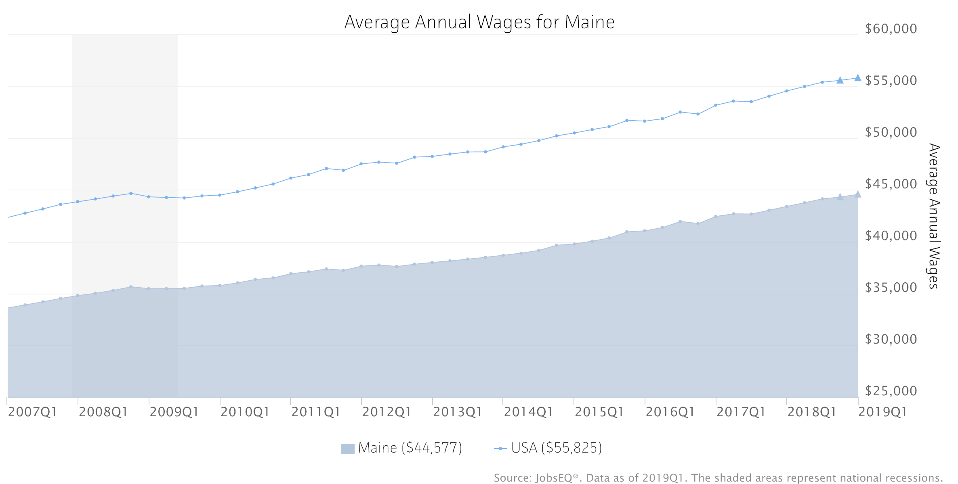

Slide 6
Occupation Characteristics

Slide 7
Why Use Labor Market Information?
Recruit and enroll students
1
Develop education and training programs responsive to the labor market
2
Guide students to make effective choices about programs and employment
3
Notes:
Understand the characteristics of the workforce
Identify local high growth, in-demand occupations
Identify skills in demand
Align educational programs with regional industry needs
Inform career decisions of students

Slide 8
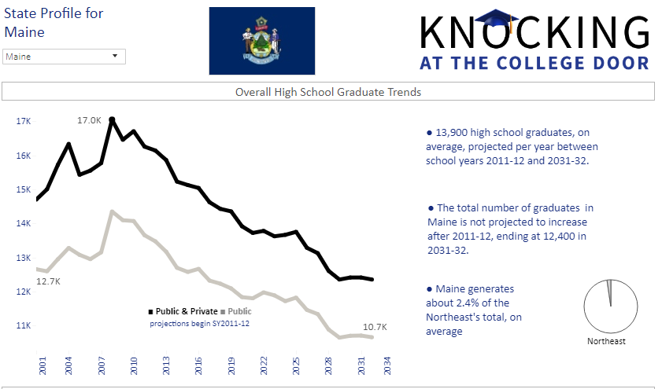
Source: Western Interstate Commission for Higher Education, Knocking at the College Door: Projections of High School Graduates, 2016, www.wiche.edu/knocking.
Notes:
Maine’s workforce challenges
Aging population
Declining number of high school graduates
Educational attainment
Shortage of skilled workers

Slide 9
MCCS Strategic Plan Keep them connected: lifelong learning and workforce development
MCCS seeks to reengineer its delivery of workforce training and to create new educational pathways that lead from short-term training to postsecondary credentials for Maine adults. The goal: to build an innovative, demand driven workforce development system that is responsive to Maine’s established and evolving industry sectors and that provides Maine people with ready access to the training and education they need to build a more prosperous future for their families and their state.

Slide 10
MCCS Licensed Tool: Chmura JobsEQ

Slide 11
Using JobsEQ to Understand Maine’s Labor Market
Demographics
Industries
Occupations
Labor and wage trends
Skills in demand

Slide 12
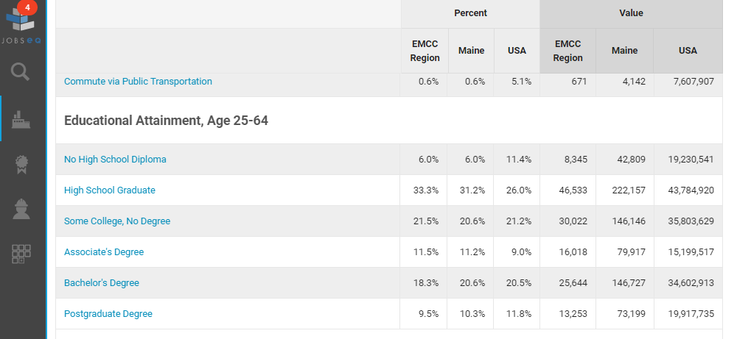
Demographic Profile

Slide 13
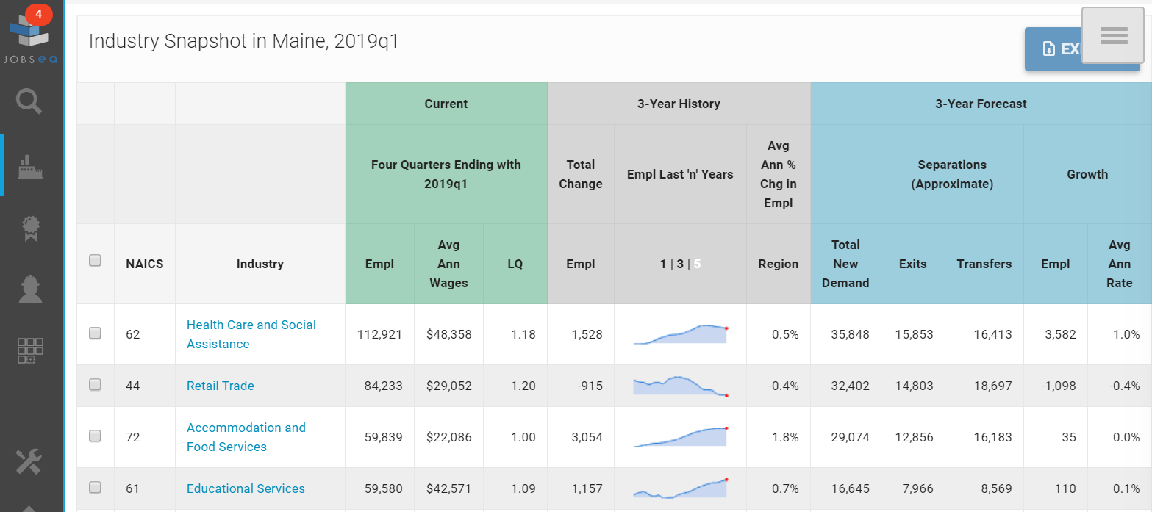
Industries by Highest Total New Demand

Slide 14
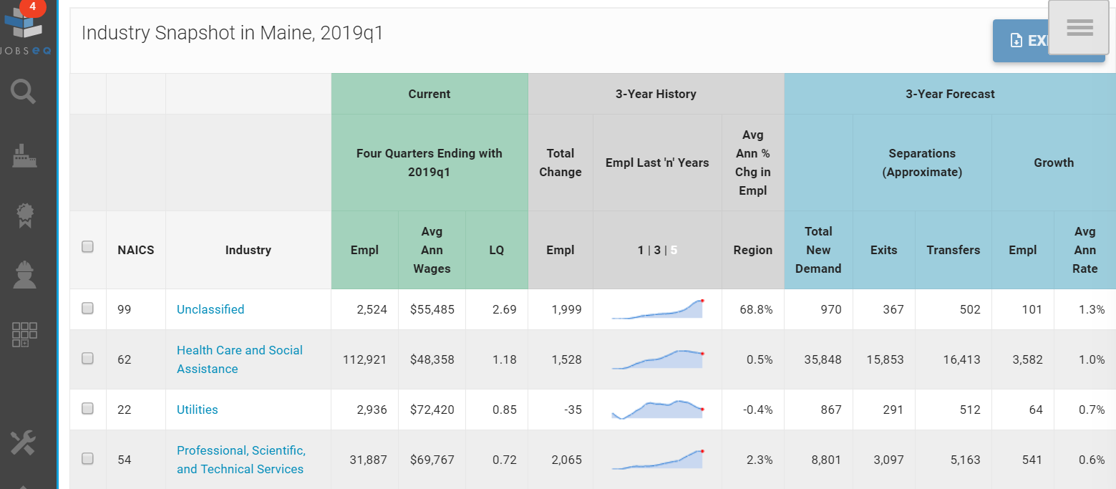
Industries by Highest Average Annual Growth Rate

Slide 15
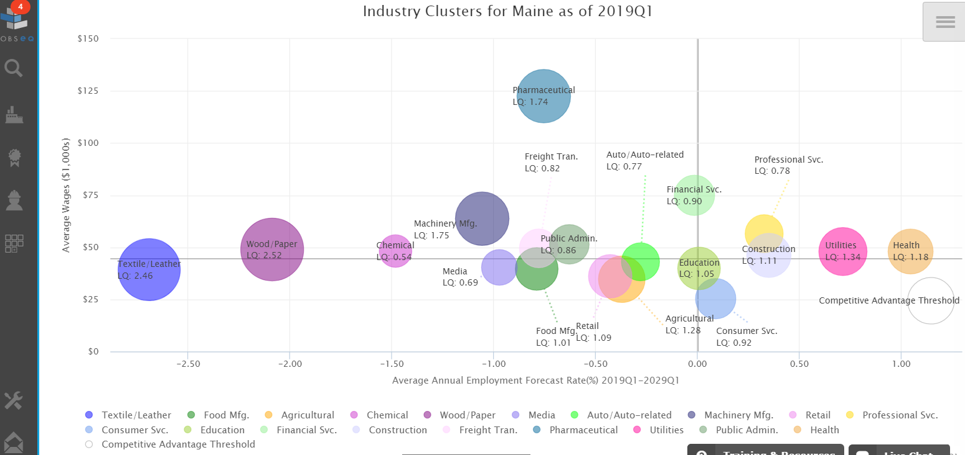
Notes:
A cluster is a geographic concentration of interrelated industries or occupations. The industry cluster in Maine with the highest relative concentration is Wood/Paper with a location quotient of 2.52. This cluster employs 13,640 workers in the region with an average wage of $48,945. Employment in the Wood/Paper cluster is projected to contract in the region about 2.1% per year over the next ten years.

Slide 16
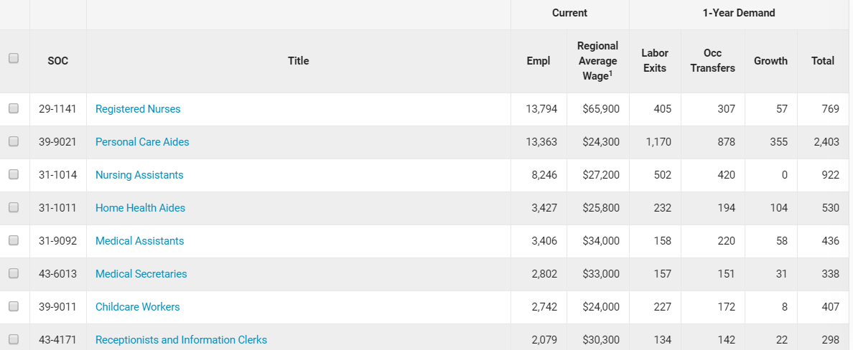
Industry/Occupation Mix for Health Care and Social Assistance in Maine, Baseline

Slide 17
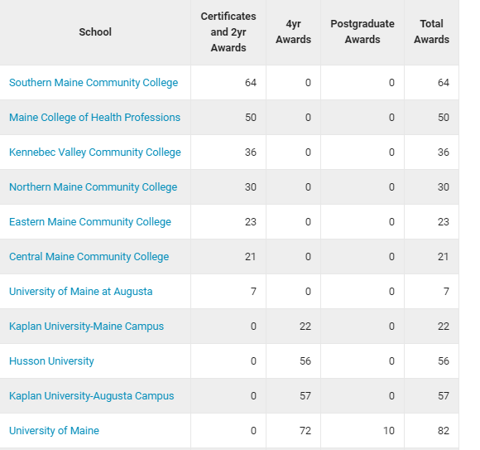
Awards in Maine for Registered Nursing/Registered Nurse (51.3801)

Slide 18
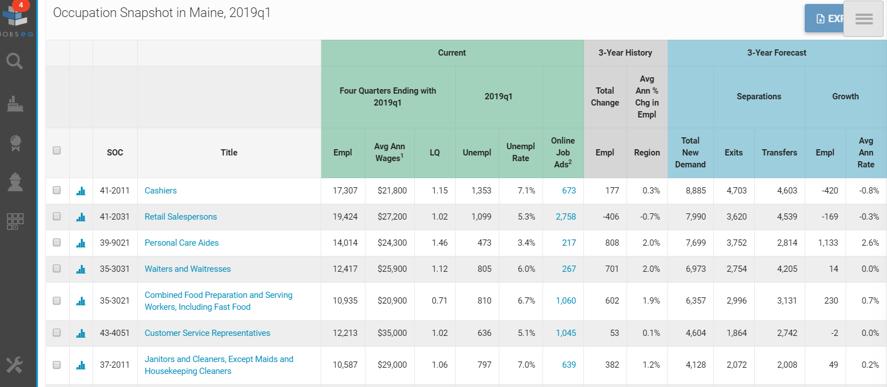
Occupations by Highest Total New Demand

Slide 19
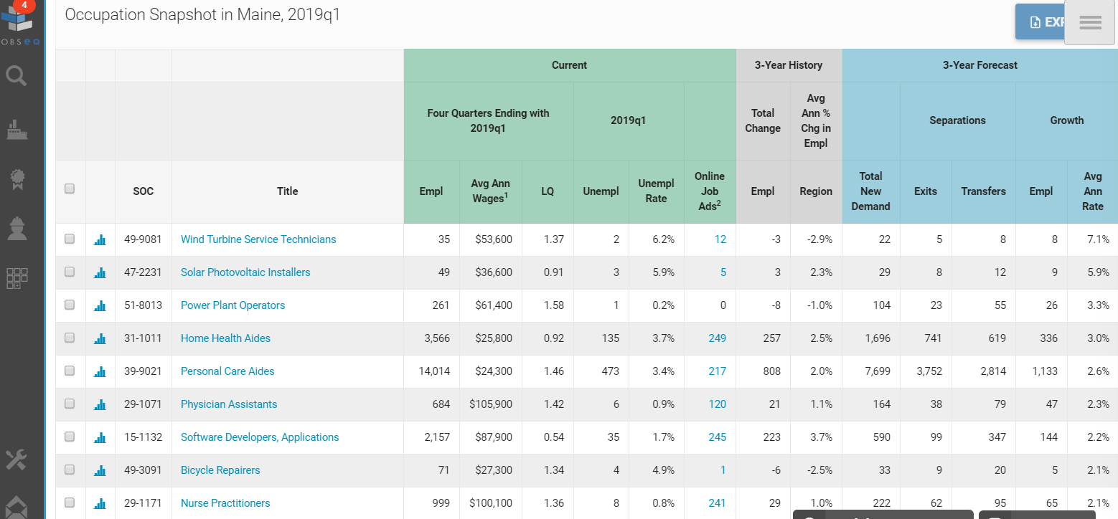
Occupations by Highest Average Annual Growth Rate

Slide 20
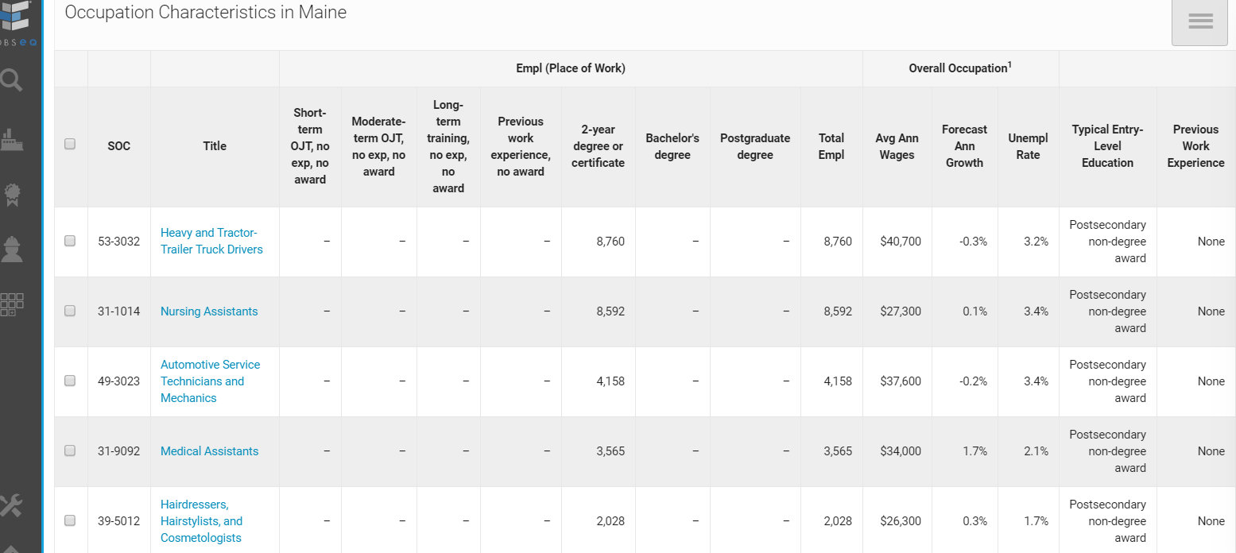
Occupation Characteristics by Highest Total Employment for 2-Year Degree or Certificate Holders

Slide 21
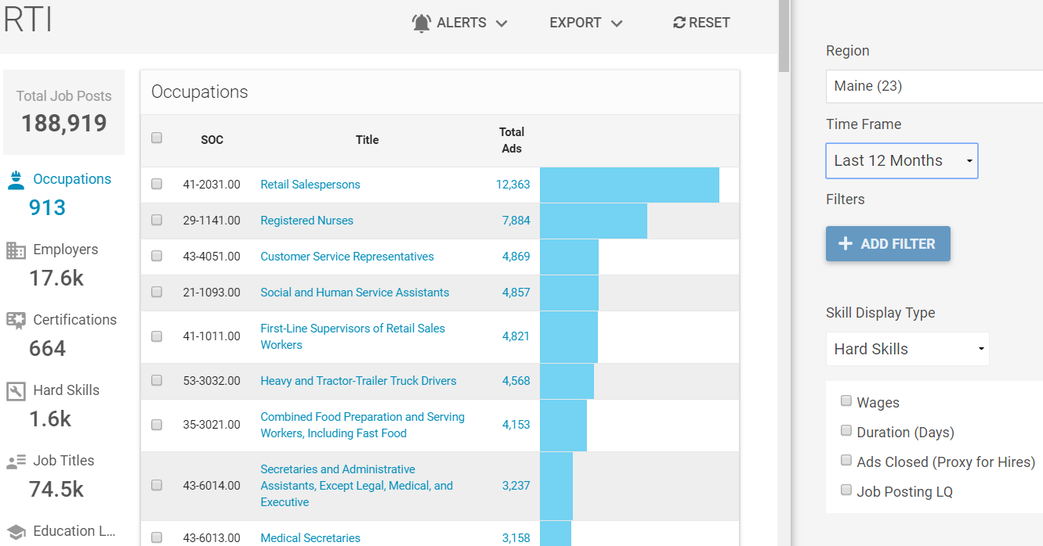

Slide 22
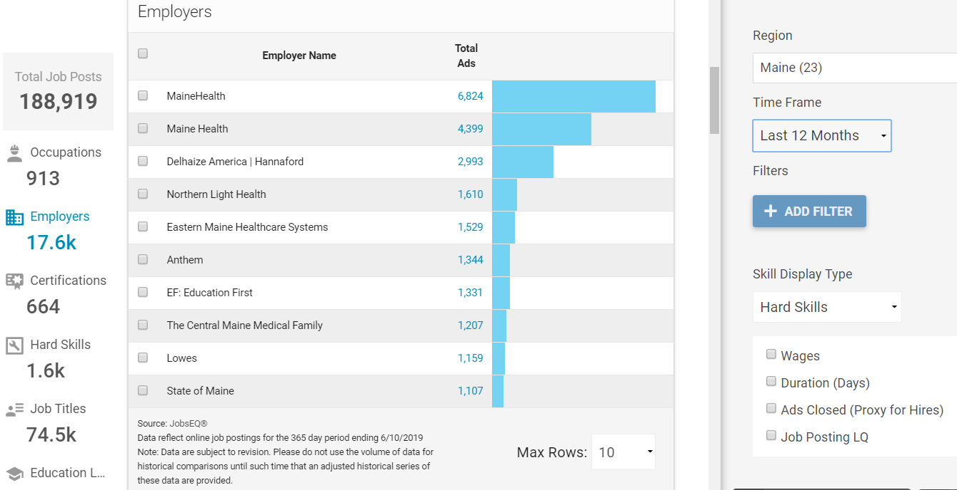

Slide 23
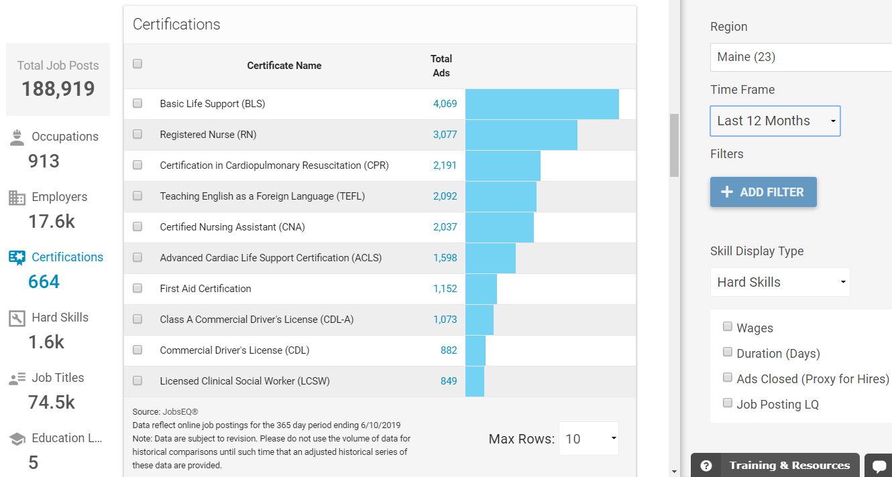

Slide 24
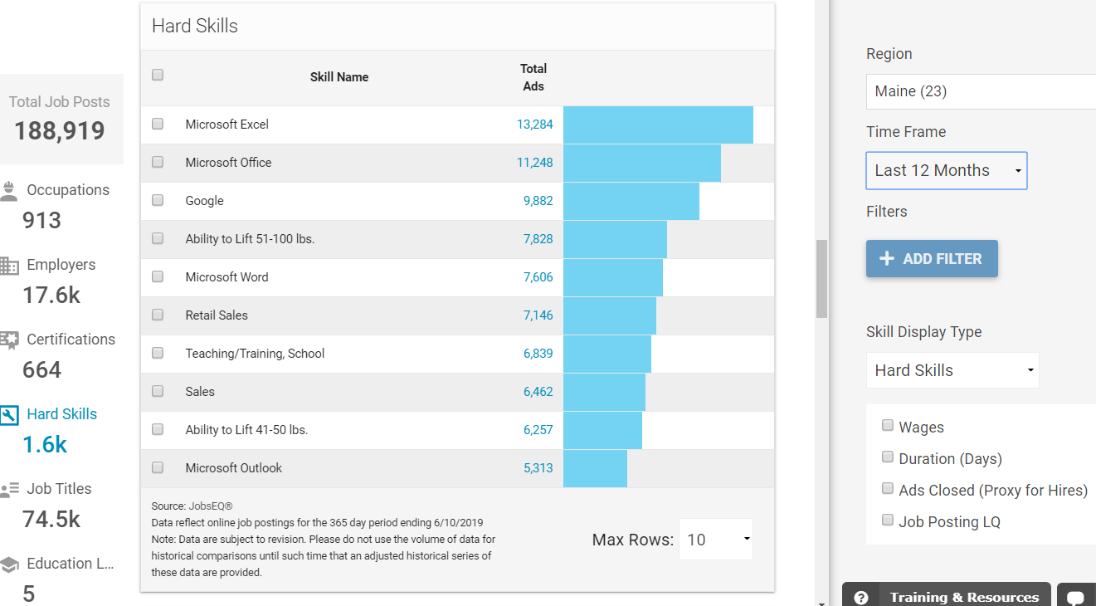

Slide 25
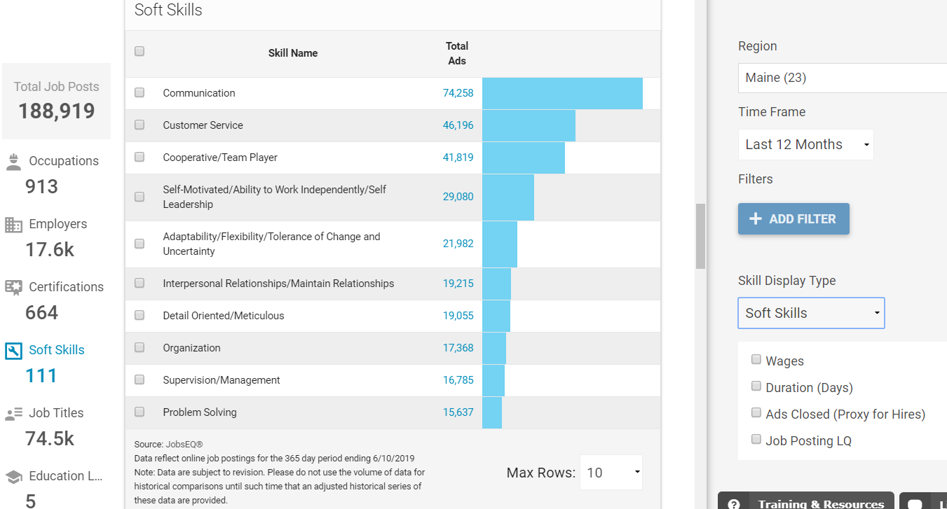

Slide 26
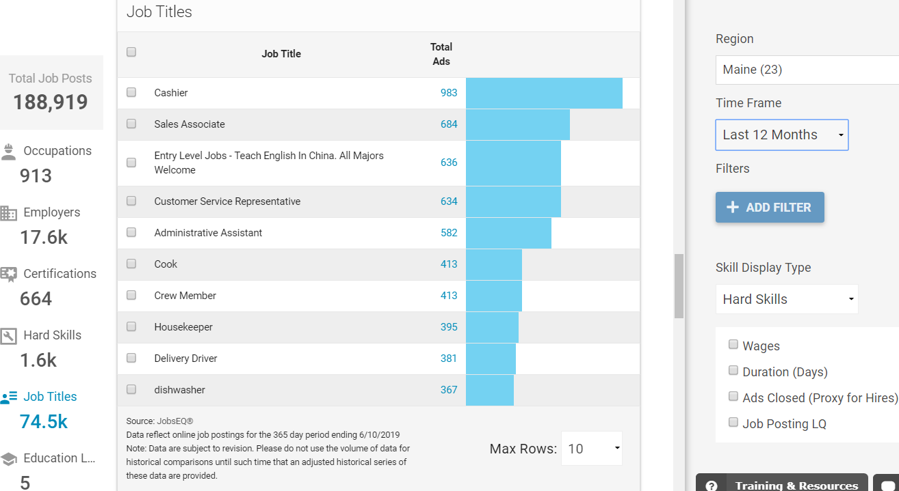

Slide 27
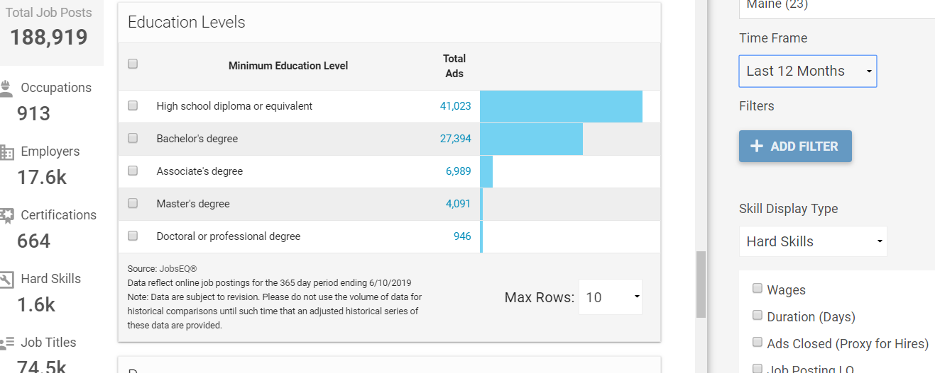

Slide 28
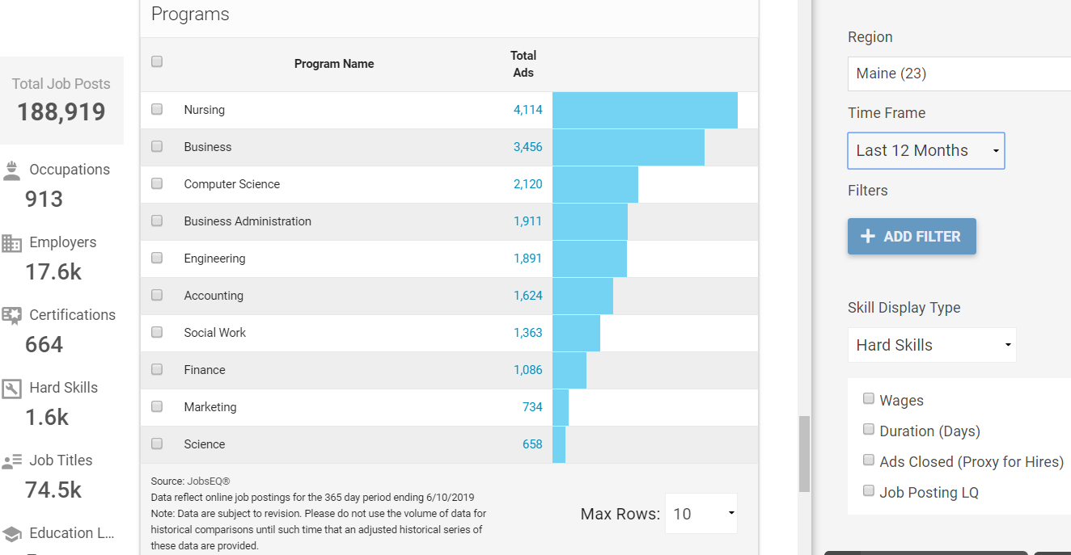

Slide 29
