Slide 1
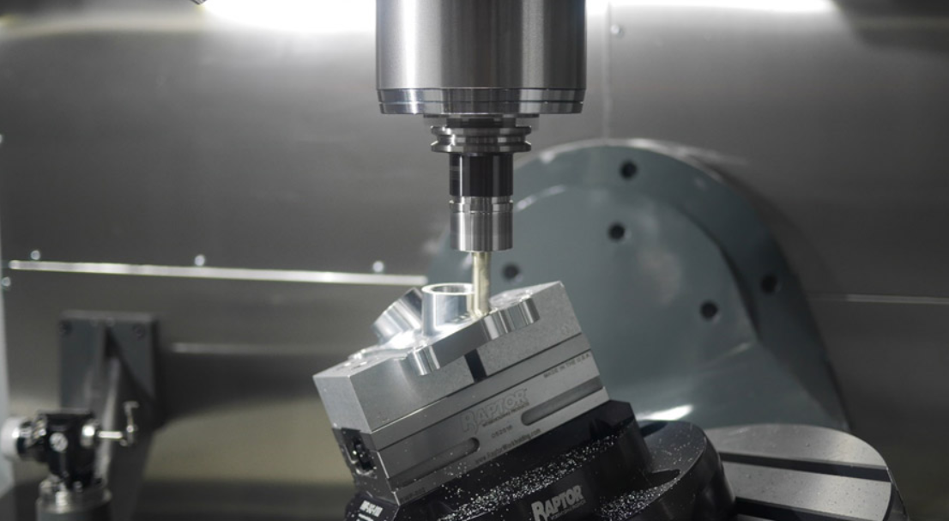
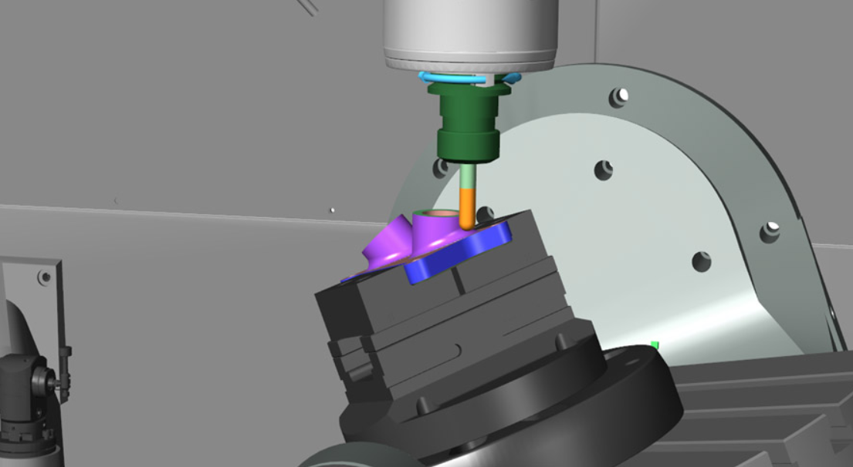
Innovation @ NMCC
Virtualization – both live &
pre-recorded
Spirit of commitment from faculty & staff
24-hour physician coverage for students
Flexibility to adapt, honed in the past six months
ACTUAL TASK
Simulated TASK
SUCCEED HERE

