Slide 2
Pandemic operations planning: 2020-2021
Kennebec valley community college

Slide 3
presentation overview
Resources and Assumptions
Phased Planning Framework
Cleaning & Disinfection Protocols
Positive Case Action Plan
Employee Access & Expectations
Communication
Student Guidelines & Technology
Customer-facing Departmental Planning
Academic Planning
Workforce Training & Professional Development Planning

Slide 4
Resources used
Federal Centers for Disease Control
Maine State Center for Disease Control
Office of the Governor of the State of Maine
Occupational Safety and Health Administration (OSHA)
Maine Employers' Mutual Insurance Company (MEMIC)
American College Health Association
MaineGeneral Health:
Steven Diaz, MD
Chief Medical Officer
Troy Cutler
Infection Preventionist
Andrew J. Dionne, MD
Chief Medical Officer
Notes:
1. Thanks to President Hopper and to all of you…
2. Two notes: because all our presentations are long and detailed, this will be a broad overview, so please feel free to ask ?s throughout for clarity, items omitted
Also, I’d be happy to share one or both of these documents
1. Silver lining = not alone, wealth of resources to consult
2. Review list, highlight MaineGeneral

Slide 5
Resources used
Northwestern University
Brown University
Purchase College
Princeton University
Utah State University
Occidental College
San Diego State University
University of Washington
University of Pennsylvania’s
Environmental Health and Radiation Safety Department
MCCS System Office and Colleges
Notes:
Here are some of the schools whose planning informed our own..
Up and including the MCCS and our sister Colleges

Slide 6
Assumptions & guiding principles
Help focus the planning team, ensure we were literally on the same page
Assumptions include that a vaccine will not be available within the next year, and that virus testing would not be feasible or ultimately helpful
Guiding principles include that our primary charge is to ensure the health and safety of our community, and that on-site courses would be limited to essential, hands-on instruction
Allow us a structure to refer back to during decision-making

Slide 7
Phased planning framework
Based on the Governor’s phased plan to reopen the Maine economy
Allows for a careful, gradual return to operations based upon conditions in the State and our community
Facilitates a “rollback” to a previous phase if conditions warrant
Phase 1: Key, On-site Staff Only
Phase 2: Selective Expansion
Phase 3: Pre-semester Stabilization
Phase 4: Fall Semester
Phase 5: A New Calendar Year
Notes:
We realized there would be steps between March and September; transition not a light switch, but a faucet
We also wanted a written, measured way forward, based on specific triggers in Maine and beyond,
And also a way backwards, as needed ;“orderly retreat”
We’re at Phase 2

Slide 8
Cleaning & disinfection protocols
What gets disinfected, when and how
Based on seasonal flu/cold cleaning protocols
Custodial shifts altered to focus on day disinfection
3rd party cleaning firm—periodic disinfection & positive case site disinfection
Positive case disinfection protocols
Based on OSHA and CDC standards
Notes:
1. Pages and pages of this…

Slide 9
Positive case action plan
Actions to take in the event of a positive case on campus
Who does what and when--actions and outcomes
Seconds don’t count, but hours do
Includes ongoing MCCS communication
Includes initial contact tracing steps to assist the DHHS & to make immediate decisions, take immediate steps
Notes:
Next, a table…
Includes initial contact tracing activities to make immediate decisions/take immediate actions & support the DHHS

Slide 10
Employee Access
Employees engage their supervisor to create a return to work plan, including rationale and schedule
Plan is shared with the Pandemic Planning Team which includes facilities, IT representatives, etc.
Proposed schedule reviewed within broader context of other employees on-site to reduce overall numbers
Accommodations are made as appropriate (different offices, different campuses, plexiglass, etc.)
Employees who wish to come on-site only occasionally need to fill out an access request form
Notes:
Accommodations details are found in our departmental plans
IT Example
Over 100 cameras on both campuses
All external doors control by central card-access system [single ingress]to assist with access control and contact tracing

Slide 11
Employee guidelines & expectations
Standard elements regarding social distancing, hygiene, face coverings, etc.
Employees disinfect their workstations before, during and after their workday
Kitchen, lounge areas
Elevators, restrooms
Separate section on PPE
Separate section on travel
Vendors considerations
Online training for education and compliance
Daily self-screening
Notes:
Disinfection wipes after
Travel decision-making includes travel, destination, activities
We’ll use the System-generated online training materials, but we didn’t want to wait

Slide 12
Communication
Text messages, emails
MS Teams/Zoom
Staff/departmental meetings
Social media/Website
Signage
Weekly all-employee video-conference for sharing information & maintaining morale, normalcy & connectedness
Notes:
Video teleconferencing used for employee/employee meetings, and also student/employee and prospective student/employee meetings
Our mission explicitly mentions “A culture of civility, cooperation, & collegiality,” although, as we’ve seen across the country, this crisis can drive people apart, we want to ensure that we come out of this pandemic stronger, and we think communication is part of that solution.

Slide 13
student guidelines & expectations
Expectations regarding face coverings, hygiene, social distancing, etc. mirror those of employees
Expectations are tied to Code of Conduct
Mobile app to ensure daily screening
“Welcome Stations” at each building’s designated ingress
Temperature scanning
Academic schedule designed in part to reduce volume

Slide 14
student technology
Public wireless access
Computer requirements: minimum specifications
Follett partnership
Dell partnership
Brightspace
Open labs—printing, software, general commuter area
Notes:
Providing shelter to students without transportation

Slide 15
Customer-facing departmental planning
Enrollment Services Center
Admissions, Financial Aid, Business Office
New Student Orientation & Advising
Support Services
Learning Commons
Counseling & Disability
Math Portal
Academic Support (Tutoring, testing, library support)
Student Navigator
TRiO Student Support Services
Jobs for Maine’s Graduates (JMG)
Embark
Food Pantry (curbside pick-up)
College Store (curbside and online ordering)
Student Life (Senate, Clubs & Orgs, Engagement)
Communication with Students
IT
Safety & Security

Slide 16
Customer-facing departmental planning Continued Conversations
Managing people & behavioral changes
Staggered schedules
New ways of doing business
Managing unique spaces that span the campus
Traffic flow floor signage
Removal of furniture
Protocols for in-person service delivery
Student Appointments
Plexi Glass Partitions
Enhancing remote delivery of services
When is face to face necessary vs remote
Serving students on campus vs remote learners
Student Life Challenges
How to engage students remotely
Retention Efforts
How to monitor and connect with students who may be struggling
Identification of needs for early intervention
Continued monitoring of technology needs
IT support protocols, new software/systems to support

Slide 17
Academic planning
Overview of Academic Plans
Brightspace
Lecture-based courses transitioned to online
Asynchronous
Synchronous
Lab, Shop and Studio Courses
Small Cohorts
Hybrid
Scheduling strategies
Clinical and Practicums
Concurrent and Dual Enrollment
Notes:
Brightspace
All credit courses will have a Brightspace presence
Implement the MCCS Brightspace standard to support student engagement and success.
Lecture-based courses have transitioned to the online format for remote learning (Breakdown
Lab, Shop and Studio
Enrollment for a live cohort
Room size, ventilation, available floor space and layout to support social distancing
Additional sections
Schedule time between cohorts for disinfection
Traffic patterns when feasible
“Frontload” hands-on instruction to be completed by November 25th
Didactic moved to online hybrid offering
Clinical and Practicums
Continue to participate as long as the sites will host
Assure that the safety standards at the site meet state guidelines

Slide 18
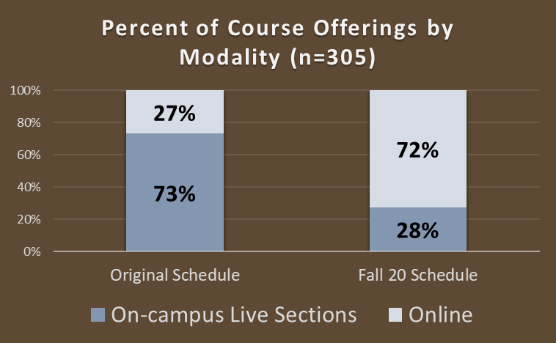
Academic planning
Notes:
Original Schedule
82 online courses
223 Live Courses (Lectures, Labs, Shops, Practicums, Clinicals)
After the transition
223 Online
84 Live (Essential Hands-On Learning)
Online Synchronous (#) representing xx percent. Of the online offerings or (x% of overall offerings.

Slide 19
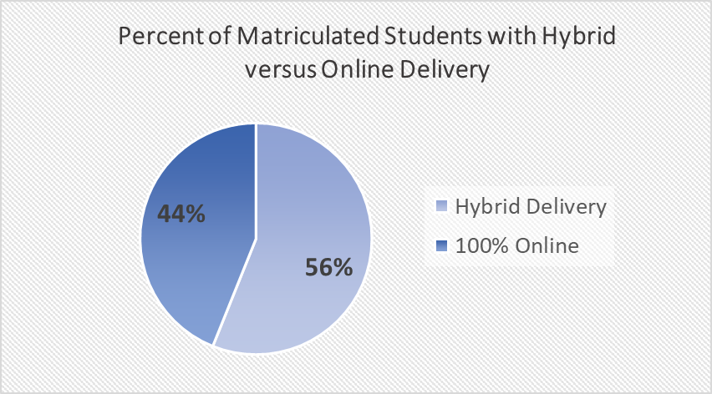
Academic planning
Programs
6 Programs fully online
17 Programs with essential hands-on experiences
Notes:
Program Delivery
Online programs – 6 programs (26%)
100% online, 599 students
Programs with Essential Hands-on Requirements – 17 programs(74%)
, 765students
Of the 1364 students, estimate that 44% will be 100% online in FA20
56% will have a essential hands-on experience

Slide 20
workforce developmentplanning
KVCC Workforce communication
When students arrive on campus
System App
Campus Access Form
Classroom and lab spaces
Class size
Classroom supplies
Equipment access
Cleaning protocols
Online classes
Textbook and material curbside pick up
Notes:
KVCC workforce instructors and students are not part of the traditional semester activities and schedule and therefore workforce will work more closely with security for students coming on to campus.
This will also require workforce to ensure that instructors and students understand KVCC COVID-19 policies.
For students attending live classes an email will be sent in advance of attending their scheduled class with expectations for coming to campus – these requirements will also be available on the workforce webpage
Cloth masks must be worn or a paper mask will be provided upon arrival
Socially distance (6’) when possible
Campus Access Instructions
Instructions on accessing campus
If no cell phone capability, students can use the KVCC Campus Access Form submitted 24 hours in advance of attendance
Labs/Classes
Class registration will be limited based on classroom size and social distancing guidelines
Each lab/classroom will be stocked with hand sanitizer, sanitizing wipes, masks and other necessary PPE
When possible each student will have their own equipment and supplies which will be disinfected after each class use
Shared equipment and supplies will be wiped down between uses
Online students may have textbooks or materials that need to picked up – students will be able to pick them up curbside during scheduled times from King Hall.

Slide 21
workforce developmentplanning
Live classes will be held for hands on training classes
Hybrid classes will be held to serve training with both classroom and lab components
Online classes
Bright Space
Zoom/MS Teams
Notes:
23 offerings in total – 61% live, 22% online, 17% hybrid
Live Classes include
BLS HCP CPR, Heat Pump, EPA608, All welding offerings
Hybrid Classes Include
3D Print, EMT, CNA, Heavy Equipment
Fully online
STEAM, NEC, Solar, HPB

